Slide 1
E-Commerce
Online Shopping
Svitlana - Maryam
WBS Coding School
Final Project

Slide 2
Introduction
The primary aim of ecommerce online shopping is to provide a convenient and efficient way for customers to purchase goods and services online. This allows customers to browse and shop from a wide range of products from the comfort of their own homes or anywhere with internet access.
ecommerce platform manage sellers inventory, track sales, and analyze customer behavior, which can help them optimize their operations and increase profitability.

Slide 3
online shopping services
Login :
User Authentication:secure way for users to authenticate themselves
Account Creation:create an account by providing user information
Password Reset:
Account Management: Users can manage their account information, such as updating their personal details, changing their password, ...
Personalized Experience: A login service allows users to access personalized features, such as viewing their order history, saving their payment details, and creating wish lists.
Security Features: A login service includes security features such as multi-factor authentication .

Slide 4
online shopping services
Business services:
Product Listings: A list of all the products available for purchase on the website, often with detailed descriptions, prices, and images.
Search and Filtering: A search bar and filters that help customers find specific products or narrow down their search results based on criteria such as price, category, or brand.
Shopping Cart: A virtual shopping cart that allows customers to add products to their order as they browse the website.
Checkout Process: An easy-to-use checkout process that guides customers through the steps of purchasing the products they've selected.
Payment Gateway: A secure payment gateway that allows customers to make payments using various methods such as credit cards, debit cards, or digital wallets.
Order Tracking: A way for customers to track the status of their orders, such as when their products have been shipped and when they are expected to arrive.

Slide 5
online shopping services
Business services:
Customer Reviews: A system for customers to leave reviews and ratings of the products they've purchased, which can help other customers make informed purchasing decisions.
Personalized Recommendations: A system that recommends products to customers based on their past purchase history or browsing behavior.
Wish Lists: A feature that allows customers to save products they're interested in to a wish list for future reference.
Customer Support: A support system that helps customers with any issues or questions they may have about the products or the ordering process.
Returns and Refunds: A system for customers to return or exchange products they're not satisfied with, as well as receive refunds for cancelled orders or faulty products.
Gift Cards: A feature that allows customers to purchase gift cards for friends and family, which can be used to purchase products on the website.

Slide 6
online shopping services
Admin Management services:
Dashboard: This page provides a high-level overview of the application's performance, including sales data, customer data, and other important metrics.
Product Management Page: This page allows the administrator to manage the products available on the application, including adding new products, updating existing products, and removing products that are no longer available.
Inventory Management Page: This page allows the administrator to track inventory levels and receive notifications when inventory levels are low, helping to ensure that products are always in stock.
Order Management Page: This page allows the administrator to manage orders, including processing payments, shipping products, and managing returns and refunds.
Customer Management Page: This page allows the administrator to manage customer accounts, including creating new accounts, updating account information, and resolving any issues related to customer orders or accounts.

Slide 7
online shopping services
content product services:
Chat GPT API can be used to generate high-quality content such as product descriptions, and more. This can save time and effort for content creators, and improve the overall quality of the content.

Slide 8
Component Diagram

Slide 9
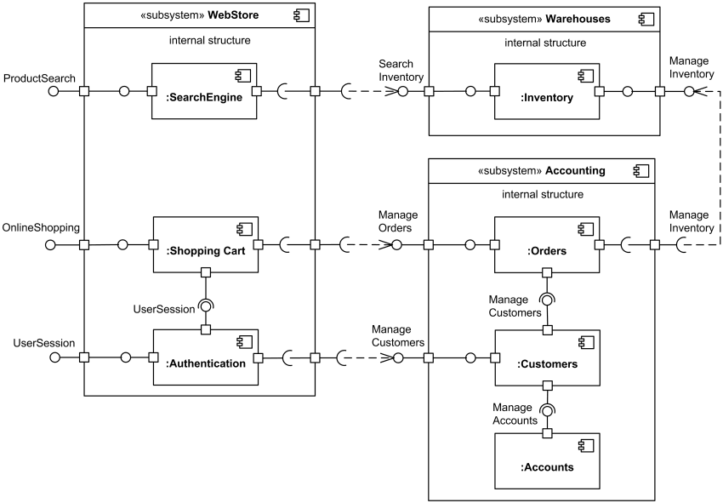

Slide 10
use case Diagram

Slide 11
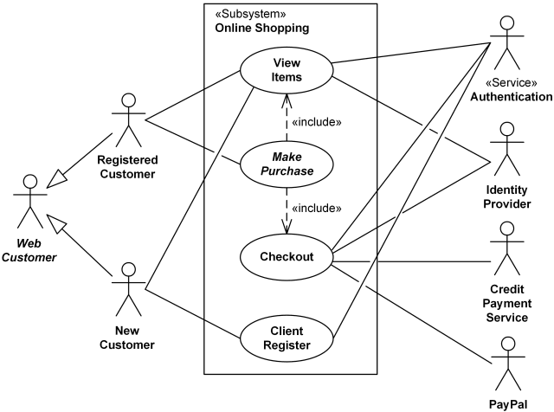

Slide 12
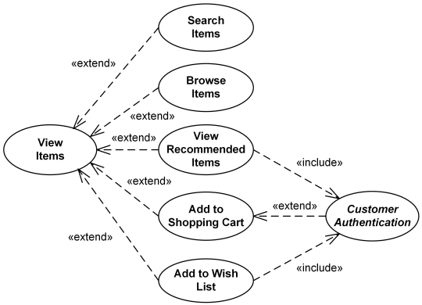

Slide 13
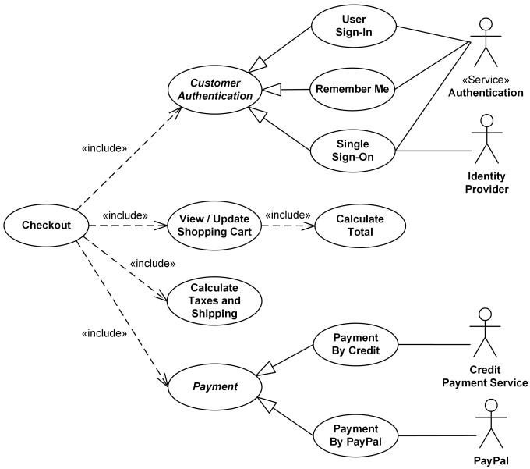

Slide 14
Sequence Diagram

Slide 15
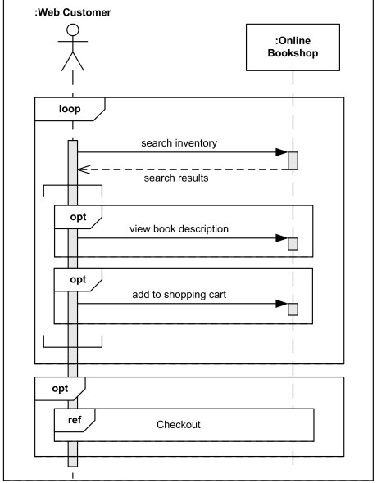

Slide 16
Activity Diagram

Slide 17
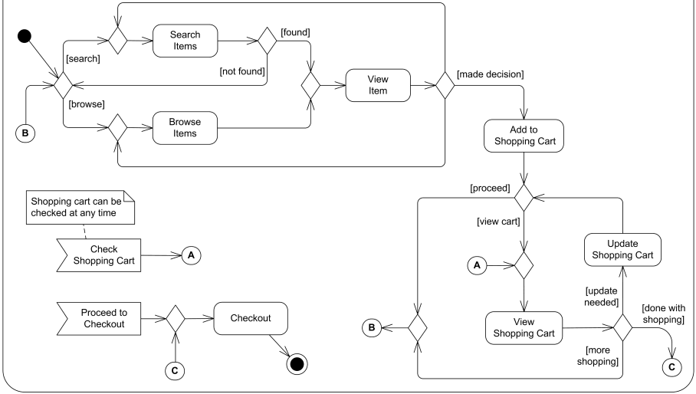

Slide 18
Data model

Slide 19
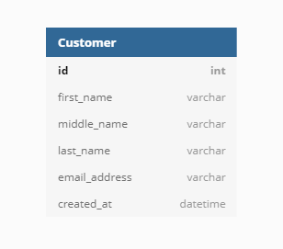

Slide 20
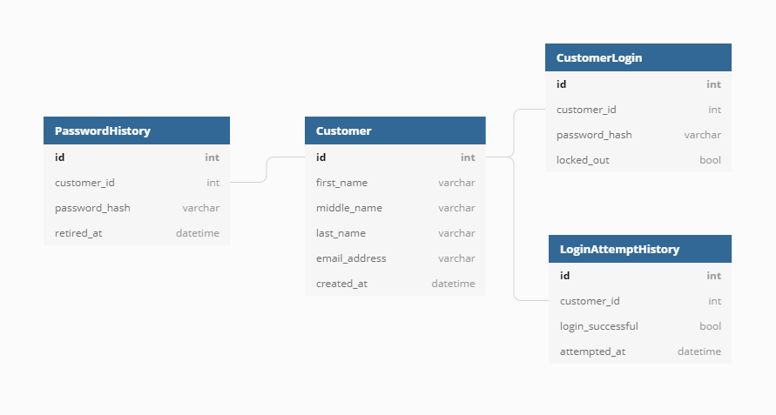

Slide 21
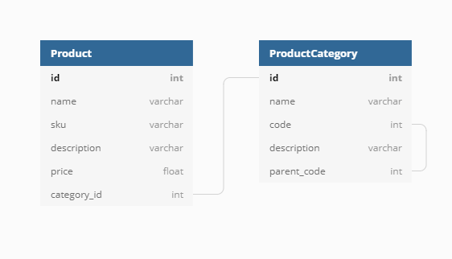

Slide 22
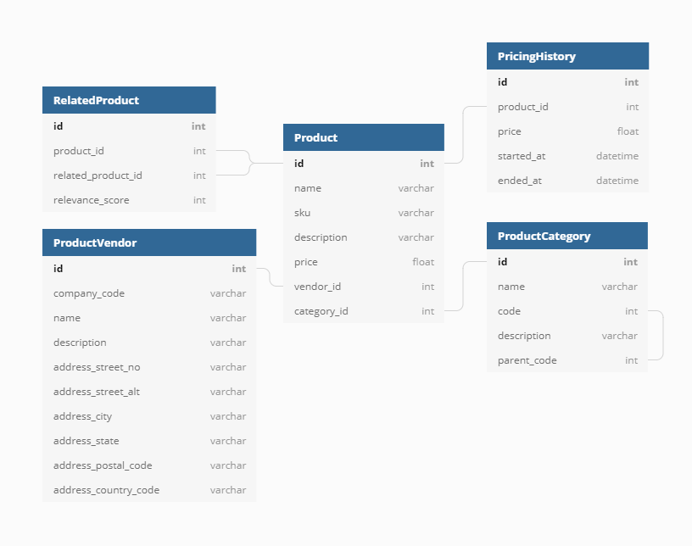

Slide 23
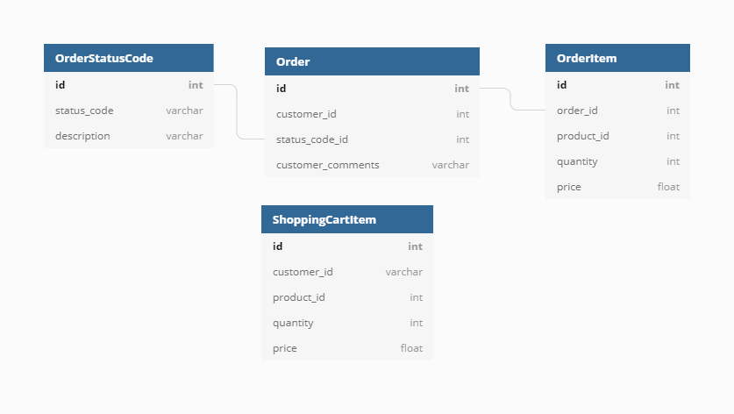

Slide 24
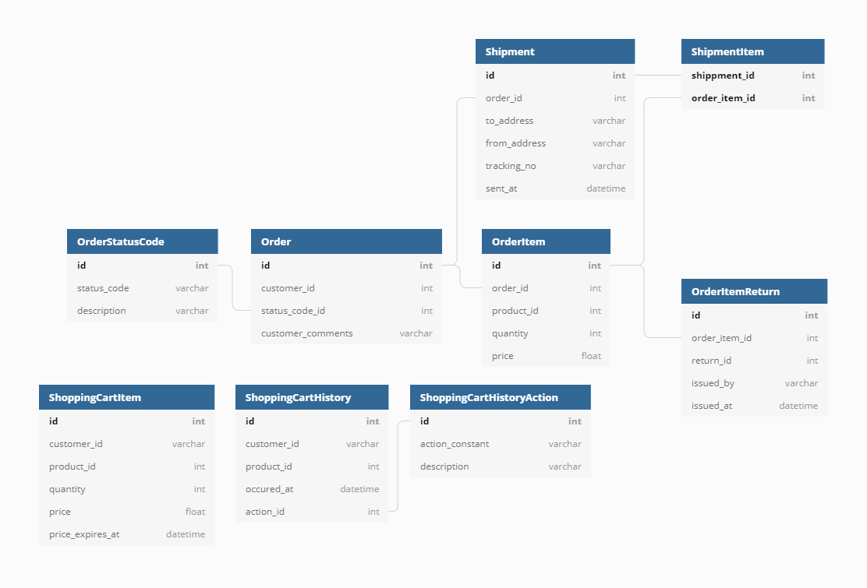

Slide 25
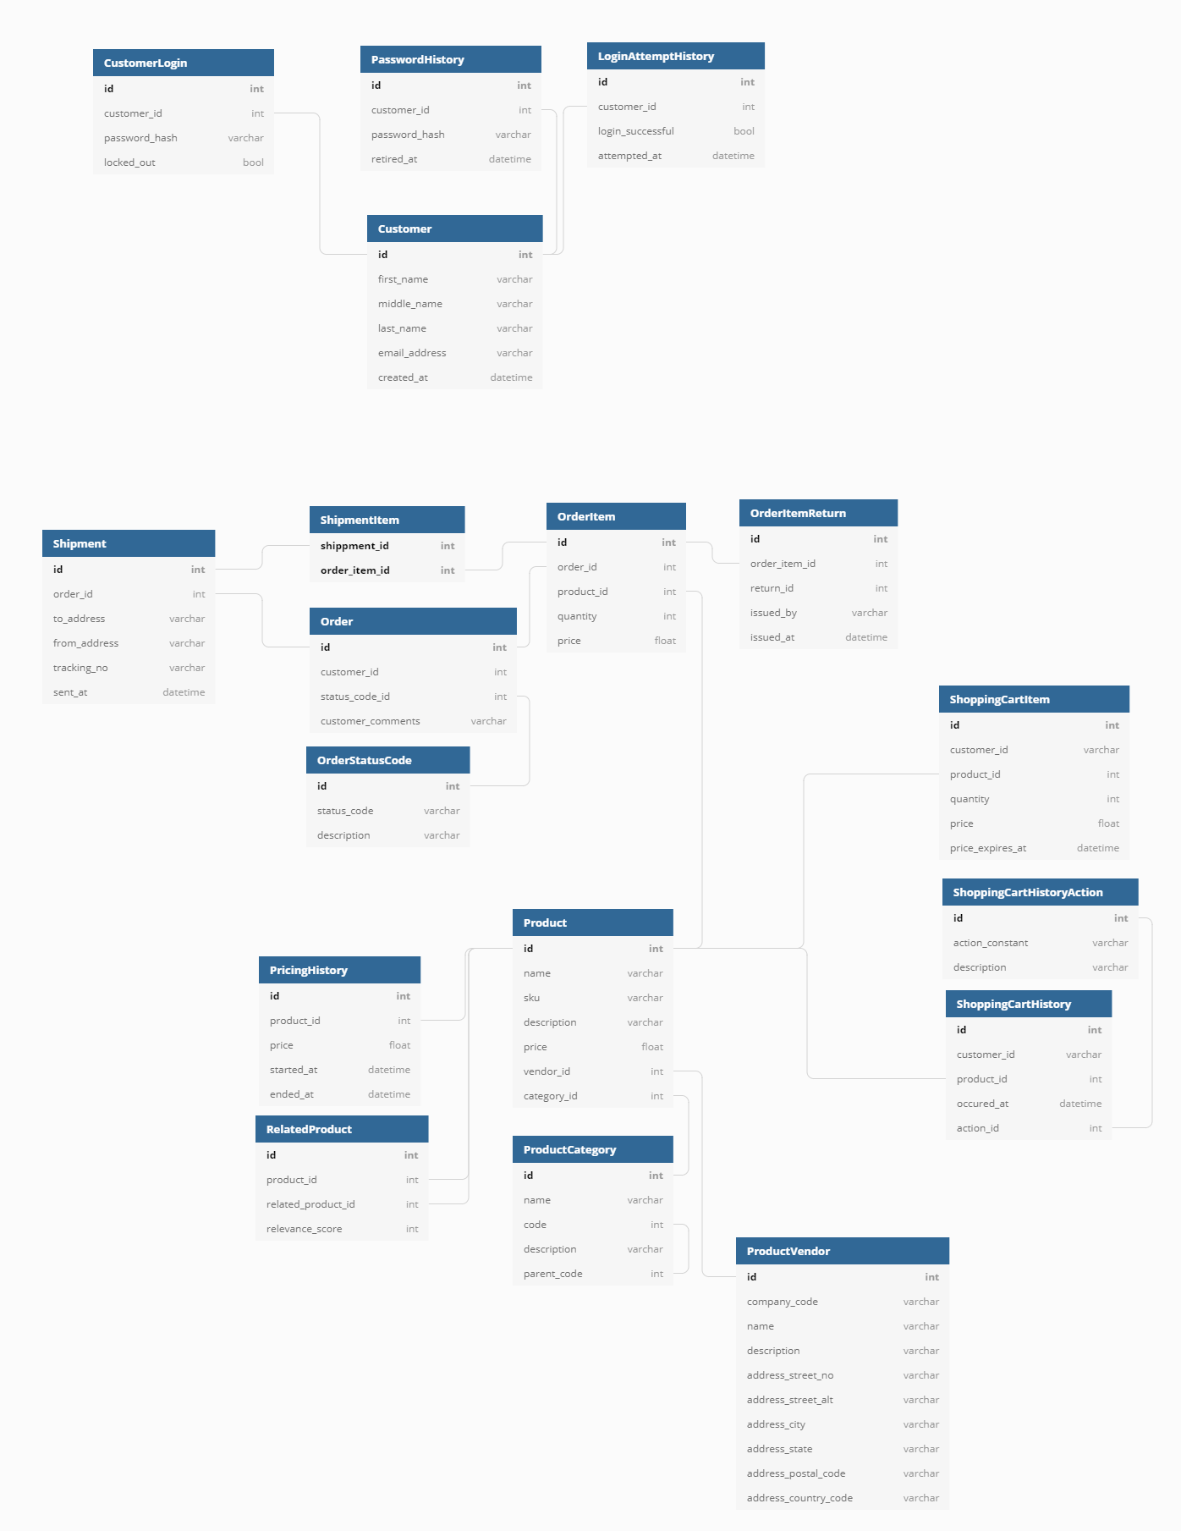

Slide 26
Thank you
question ???

